Slide 1
ML Career Service Platform
Project Demo
Team 3 :
Menita Koonani - koonani.m - 001883043
Raghavi Kirouchenaradjou - kirouchenaradjou.r - 001826638
Sreerag Mandakathil Sreenath - mandakathil.s - 001838559
CSYE7200 - Big-Data Systems Using Scala
April 18, 2019

Slide 2
The What and Why?
Have you been in a situation you wished you knew what Job title or Job description will best suit your skill set?
Have you wished that you have a service in which you would be sent job recommendation and their salary insights based on your skill sets?

Slide 3
Use case
Actor :
A user (In this case a graduate student) will initiate the interaction with the web api
Action :
The user will upload their resume in pdf/text format to the web api via Rest client like Postman
Reaction :
The system will recommend the user the best job titles based on their skills mentioned in the resume. The system will also send in URLs to apply for the suggested job titles. Predict salary expectation in different profiles and which is best suitable for that resume

Slide 4
Methodology
Data Collection via Web crawling
04
Web API service for easy user interaction
01
03
Data Wrangling and Storing
Creating Machine Learning models for the recommendation system
02

Slide 5
Methodology - 2
Scraping information and skill sets from websites such as Glassdoor,Indeed
Analysing the data and categorizing the content based on the job description
The data will be stored in a data file for further processing
Test different machine learning models to optimise the result
To make a web based application to interact with the system through which the user can upload their data
Parse the users resume and scrape relevant information i.e. tools, skills, location, work experience and serve it as parameters for our prediction model

Slide 6
Data sources, enumerating the magnitude
Scraping information and skill sets from websites such as Glassdoor,Indeed
This will be done by giving the url as input to a web scraper
Library such as python’s scrapy will be used to run multiple web crawlers on a single website to optimise scrapping process
We will have 100 or more job posting per Job title
The focused Job titles : Software Developer, Web Developer,Data Analyst, Data Scientist, Dev-Ops Engineer etc..

Slide 7
Milestones/Sprints
Week 1
Week 2
Week 3
Week 4
Week 5
Write Scrapping code
Data Preprocessing and Exploratory Data Analysis
Model Building, Training, Selection
Creation of Web Rest APIs for a given user
System integration and documentation

Slide 8
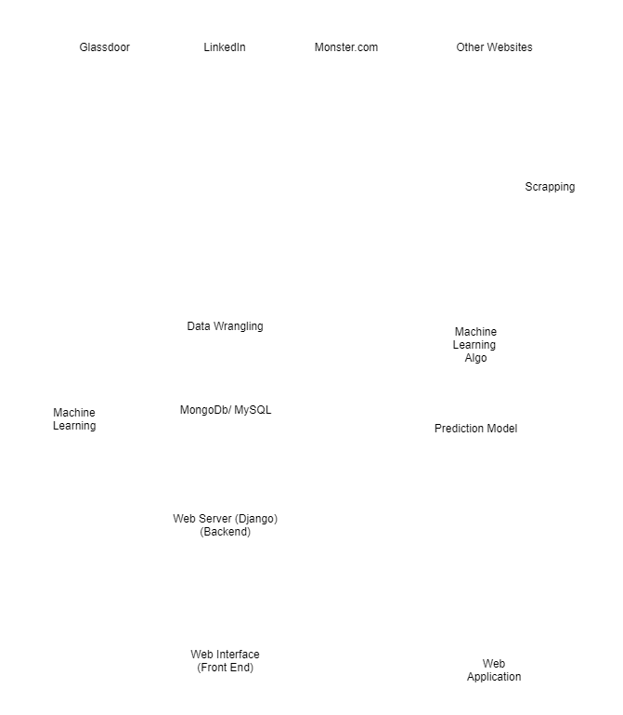
Python
Development Stages and Languages
Scala/Spark
csv
AKKA HTML
Web Api

Slide 9
Proposed Technology
We will be using scala libraries to power this solution, such as:
SNo. | Task | Library
1. | Web Scraping | Python : Scrapy, Beautiful Soup and LXML
2. | Data Cleaning | Scala/Spark : RegexTokenizer and StopWordsRemover
3. | Classification and ML modeling | Scala/Spark : NLTK and Classification
4. | Web Server and Rest API | Scala : AKKA HTML

Slide 10

Code Repository
https://github.com/sreeragsreenath/Scala_Project_ML_Career_Service

Slide 11
Acceptance Criterion
Tasks | Criterion | Achieved?
Web Crawling / Scraping | Collect at least 100 Job posting for 5 Job Titles | Yes
Model and classification | Try to classify new job posting with the training data set to have at least 70% accuracy | Yes
Web API | Create a working web api which can be accessed via postman or other rest clients to upload the resume as either text or pdf and return a json based result for the user | Yes

Slide 12
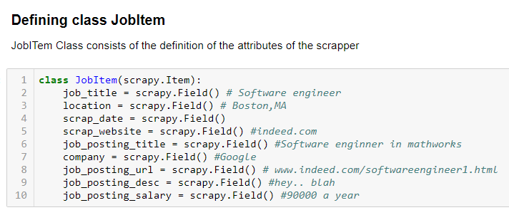
Web Scraping : Defining attributes to scrap

Slide 13
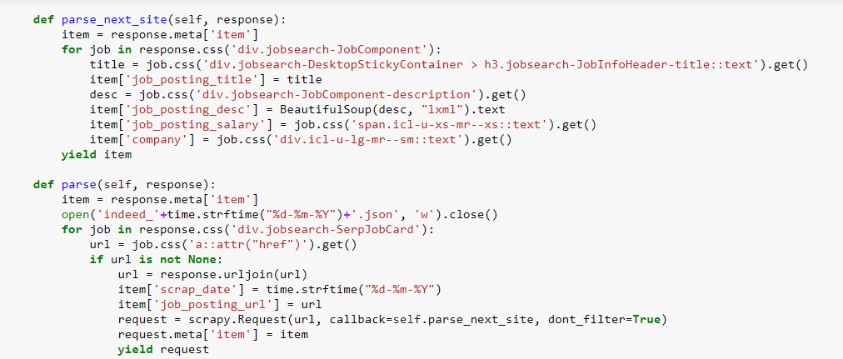
Data Scraping: Parsing Job Position URLs

Slide 14
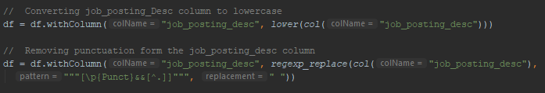
Data Cleaning: Removing punctuation

Slide 15
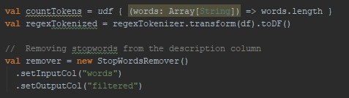
Data Cleaning: Removing stop words

Slide 16
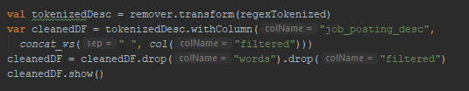
Data Cleaning: De-tokenizing words

Slide 17
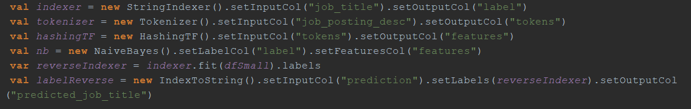
ML Pipeline

Slide 18

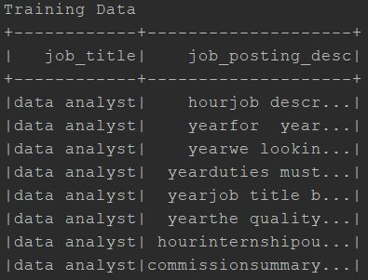
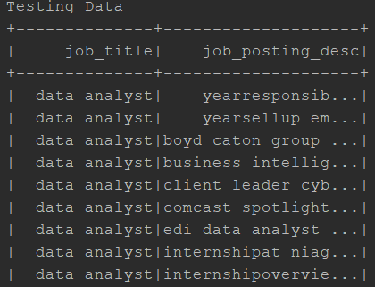
ML : Naive Bayes Data split (70-30)

Slide 19
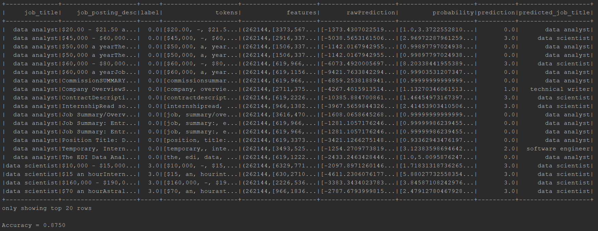
ML : Naive Bayes Classification (raw)

Slide 20
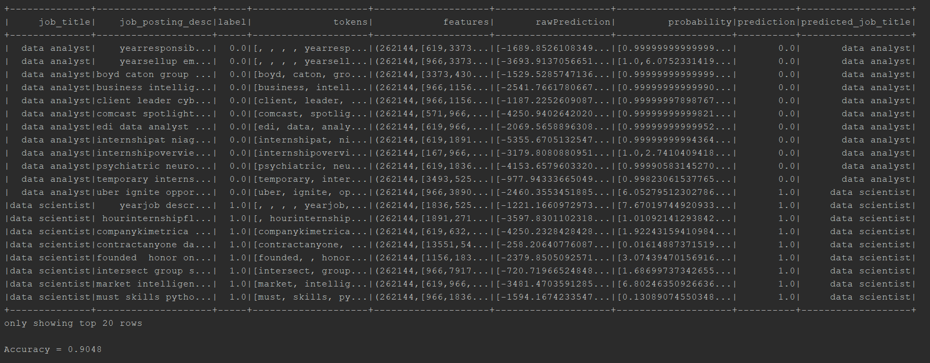
ML : Naive Bayes Classification (cleaned)

Slide 21
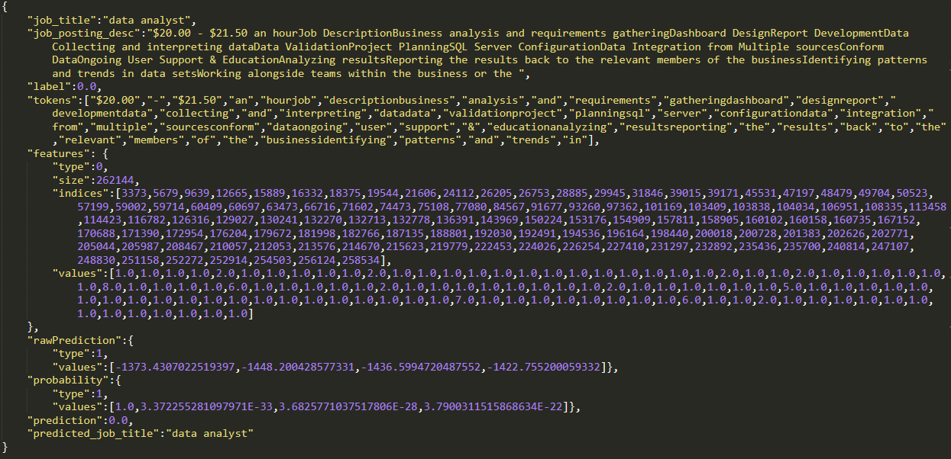
ML : Naive Bayes Classification (json output)

Slide 22
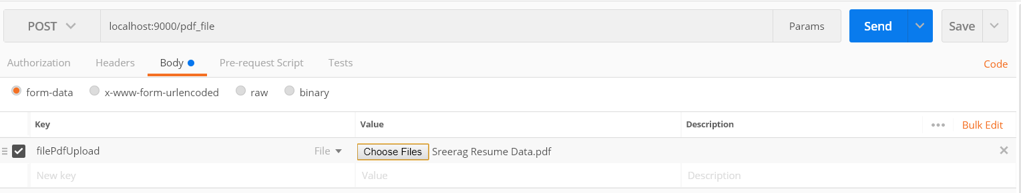
Akka Web server : Post PDF : request

Slide 23
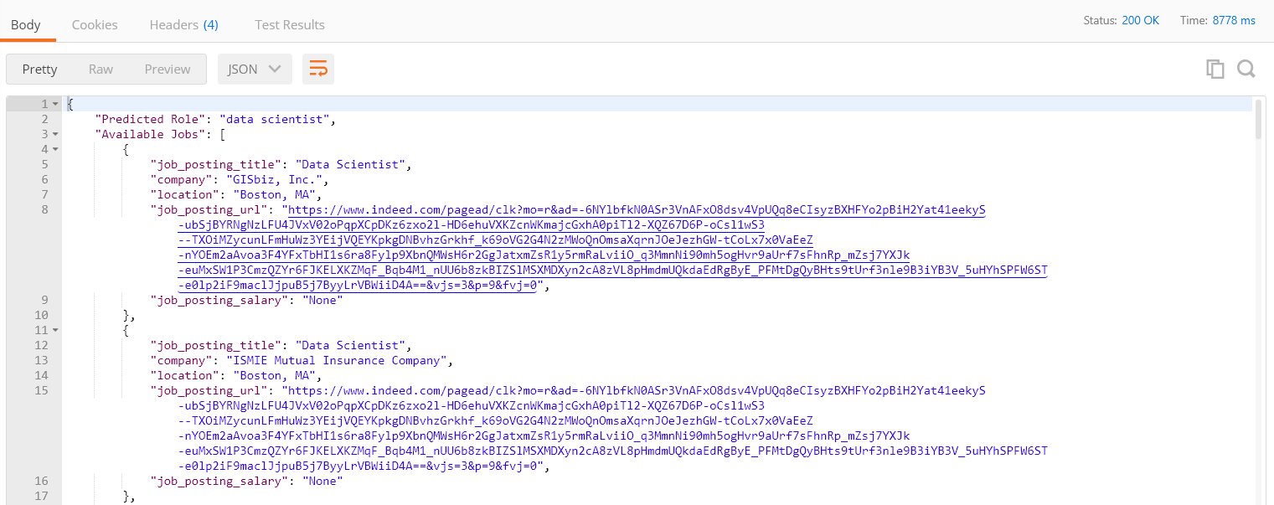
Akka Web server : Post PDF : Response

Slide 24
Goals
MLBC is Web based system is for candidates who are seeking a job and recruiter who are looking for the right talent.
The platform scrapes and analyzes publicly available job posting data from sites like Indeed, etc.
The system will recommend the candidate which job title will fit them based on their resume. The system will also give job links to the suitable for them.
The platform will help us to gain statistical information about the latest job trend.

Slide 25

Questions

